Slide 1

Emitter follower
RBT125
Marbin Godinez

Slide 2
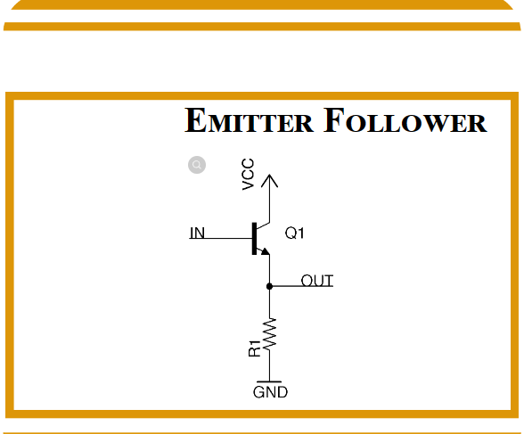
Emitter follower
THE EMITTER FOLLOWER IS ALSO KNOWS AS A COMMON COLLECTOR TRANSISTOR.
Basic components for an emitter follower are and may include:
TRANSISTOR
BATTERY
RESSITOR
LOAD RESISTOR
Notes:
The emitter follower is a buffer stage with an approximately unity gain, high input impedance, and low output impedance.
The fact that it has a high input impedance, and a low output impedance is its most crucial feature makes it a prefect circuit for impedance matching.
The name “common collector transistor circuit configuration” comes from the fact that the collector circuit is shared by both the input and output circuits
The common collector is also known as an emitter follower, the name comes from the fact that the emitter voltage “follows” the base voltage

Slide 3
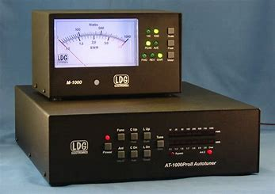
Usage
Emitter followers are most used in:
Antenna tuners
Acoustic horns
Baluns
Simple motor speed controller
Hi-Fi power amplifier
Simple variable power supply
Signal generator circuit
Notes:
When you connect the load between the ground and emitter, the base won’t have a high impedance. And it also means that the base circuit has protection from high wide range current. So, it doesn’t need high resistance for protection. Plus, the base terminal isn’t vulnerable to connect to the ground rail via the emitter.
The emitter follower is the network you get from using an emitter terminal as output in a BJT configuration
The transistor circuit follows the transistor’s base voltage, and it does this in a way that the emitter terminal’s output is always equivalent to the base voltage minus the base-emitter junction’s forward drop

Slide 4
Advantages
Some advantages of implementing a emitter follower are that:
Voltage gain is none or almost one.
Main purpose of an emitter follower is to serve as a buffer
Notes:
There is no voltage gain. Voltage gain is almost one
Current gain and power gain are both relatively high.
Input impedance is high, and output impedance is low, so it works as a great buffer.
The main advantage of an emitter follower circuit is that it provides a high input impedance and a low output impedance, making it an ideal circuit for applications where a high impedance input signal needs to be buffered or amplified.

Slide 5
Disadvantages
Some disadvantages include:
Voltage drop can't go over 1
Transistor can overheat
The emitter follower's frequency response is not as wide as some other amplifier configurations
Notes:
Although an emitter follower's voltage gain is less than one and can be beneficial in some situations, it can also have limitations when significant voltage amplification is needed.
Emitter follower circuits can dissipate a significant amount of power in the transistor itself, which can lead to the transistor heating up too much.
The emitter follower's frequency response is not as wide as some other amplifier configurations this can limit its usability in applications requiring high-frequency amplification.

Slide 6
Variations of the circuit
Some variation of the emitter follower are:
The Cascode emitter follower
The Darlington pair
The complementary emitter follower
Notes:
The cascode emitter: a second transistor is connected in a common base configuration on top of the first emitter follower transistor which improves the frequency response and can provide higher overall gain.
The Darlington pair is a combination of two transistors in a single package, it's used to achieve a higher current gain and better overall performance.
The complementary emitter follower is a variation that uses both NPN and PNP transistors in a push-pull arrangement to provide both positive and negative voltage amplification it's commonly used in power amplifier stages to drive loads like speakers efficiently.

Slide 7
REFERENCES
tutorialspoint. (n.d.). Emitter Follower & Darlington Amplifier. Www.tutorialspoint.com. https://www.tutorialspoint.com/amplifiers/amplifiers_emitter_follower_and_darlington.htm
eeeguide. (2019, March 24). Complementary Emitter Follower Circuit. EEEGUIDE.COM. https://www.eeeguide.com/complementary-emitter-follower-circuit/#:~:text=Complementary%20emitter%20followers%20have%20similar%20signals%20applied%20simultaneously
Chaudhary, B. (2022, September 16). Emitter Follower : Working, Characteristics and Its Applications. Semiconductor for You. https://www.semiconductorforu.com/emitter-follower-working-characteristics-and-its-applications/
Zhao, H. (2021, December 21). Emitter Follower Circuit: The Basics and How to Create One. Circuit Board Fabrication and PCB Assembly Turnkey Services - WellPCB. https://www.wellpcb.com/emitter-follower-circuit.html#:~:text=You%20can%20use%20an%20emitter%20follower%20circuit%20for
Hareendran, T. K. (2023, April 25). Emitter Follower – A Quick Look. Codrey Electronics. https://www.codrey.com/electronics/emitter-follower-a-quick-look/
Notes:
References

